Slide 1
Paper Presentation
Jose Perales, Ishrat Naba, Simrat Benipal
Group # 11
Netflix II

Slide 2
Modeling the role of police corruption in the reduction of organized crime: Mexico as a case study
Andrés Aldana, Hernán Larralde, Maximino Aldana

Slide 3
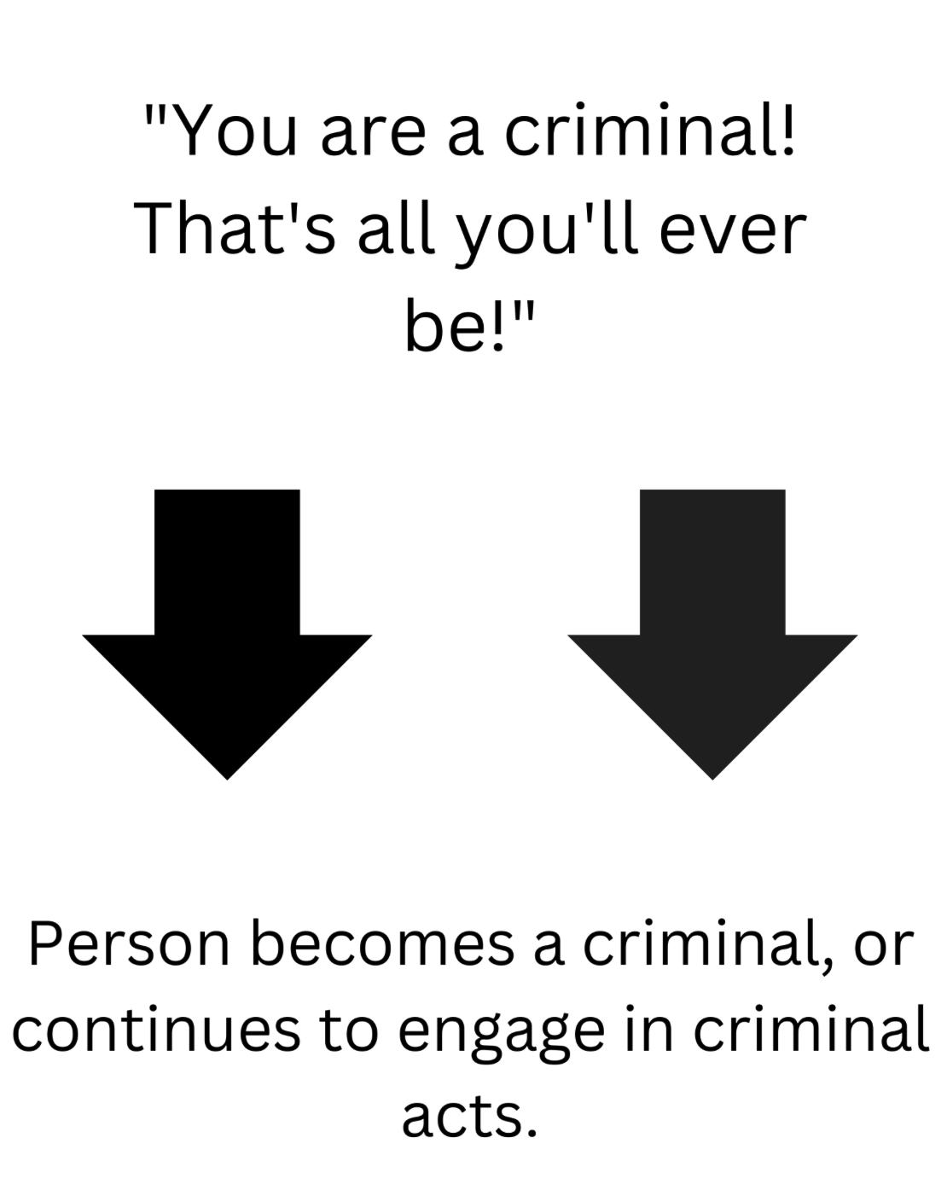
Introduction
Model the role of police corruption in Mexico and its impact on the reduction of organized crime.
Corruption is difficult to measure. Mostly done through perception surveys.
How do crime levels change as a function of police corruption and its perception?
Restoring public confidence in law enforcement could be as important as direct measures against corruption to reduce crime.
Labeling Theory of Criminology:
Labeling someone a criminal makes that person more likely to commit criminal acts

Slide 4

Methodology
Agent-based model to explore the dynamics between police corruption, public perception of corruption, and crime rates in Mexico.
An agent-based model simulates interactions of individual agents to assess their effects on the system.
Agents: police officers, criminals, regular citizens.
Examine emergent behaviors arising from the rules governing individual actions and interactions.

Slide 5
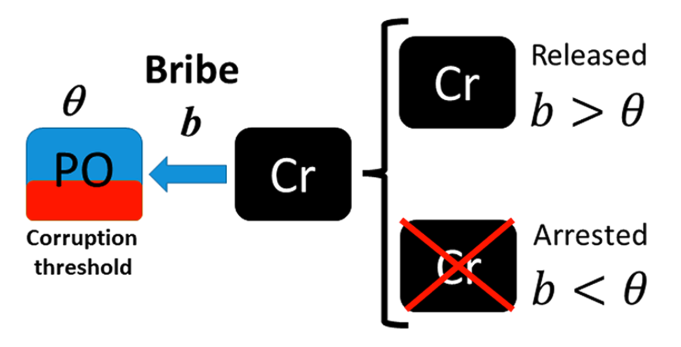
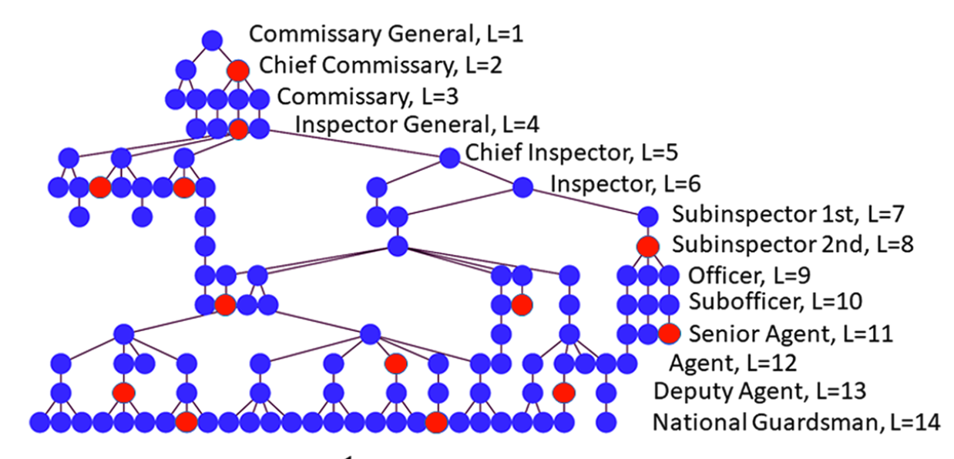
Methodology
Simulation runs over time to observe how crime spreads across the population under different conditions.
Simulations produce a variety of outcomes under different scenarios. Showing how changes in police corruption and public perception can impact crime incidence.
Valuable tool for policymakers to improve public safety.
Police officers have a corruption threshold 𝛳.
For honest officers, 𝛳 = ∞.
𝛳 corresponds to an officer’s level. Lower levels have a low 𝛳, while higher ranking ones have a higher 𝛳.

Slide 6
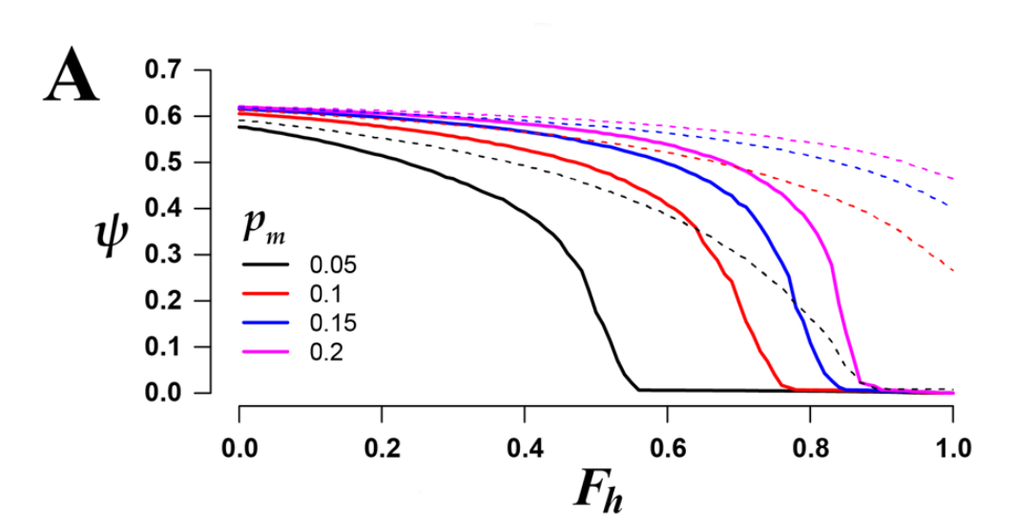
Main Findings
Relationship between crime incidence rate (y-axis) and percentage of honest officers (x-axis).
Fraction of honest officers increases as we move to the right.
Different colors indicate different levels of “maximum turning probability” (probability that an honest officer becomes corrupt).
Solid lines represent no inflated perception of corruption, while dashed lines show an inflated perception.
Notes:
#1

Slide 7
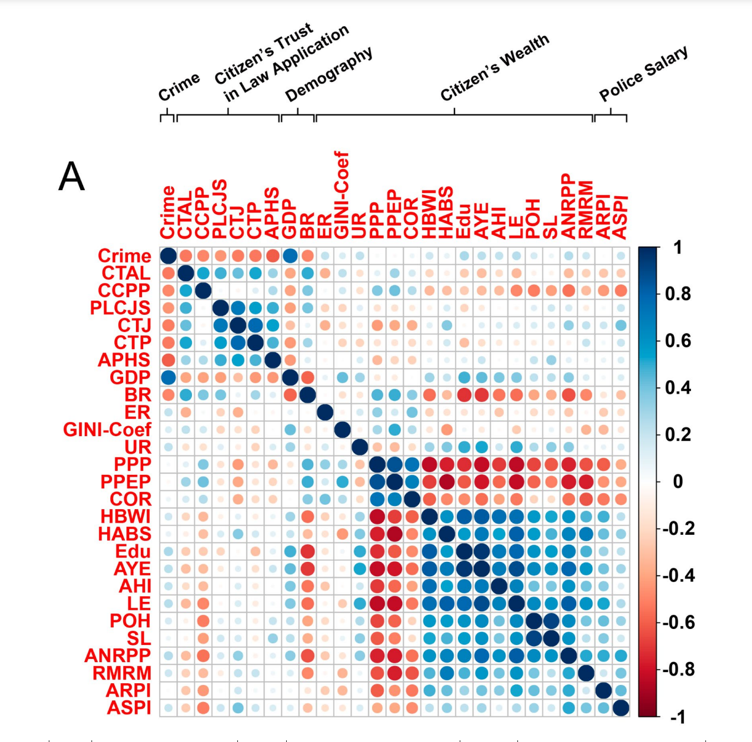
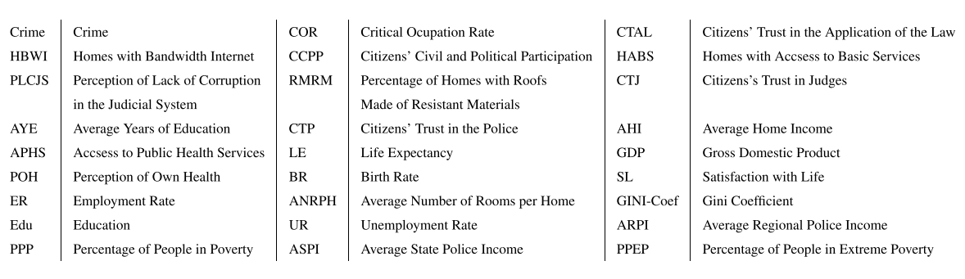
Figure A shows the correlation between crime incidences and 25 different indicators of Social welfare.
Crime is not significatively correlated with social welfare indicators such as family income, poverty, education, etc.
Crime is anti-correlated with trust and confidence in police corporations and the justice system (red dots, first row and column).
Crime is positively correlated to GDP (First row, blue dot)
Crime is higher, citizens trust in the police and justice system is considerably lower.
Reason for this anticorrelation may be due, indeed, to there being more police corruption in the regions affected with higher crime rates.
Another possibility is that it is easy to get away with the crime due to less trust in the judicial system.
Notes:
#2
Figure A shows the correlation between crime incidences and 25 different indicators of Social welfare.
It can be observed the crime is not significatively correlated with social welfare indicators such as family income, unemployment or police salaries or poverty, education.
But crime is significantly anti-correlated with trust and confidence in police corporations and the justice system (red dots, first row and column). (more trust, less crime or less trust leads to more crime
Crime is positively correlated to GDP (First row, blue dot) (more GDP, leads to more crime)
Crime is higher, citizens trust in the police and justice system is considerably lower.
One possible reason for this anticorrelation may be due, indeed, to there being more police corruption in the regions affected with higher crime rates.
Another possibility is that the perceived police and judicial corruption may lead citizens to believe that they can get away with crime unpunished.
Red means more negative relation and blue means more positive relation???????? A positive correlation indicates two variables that tend to move in the same direction. A negative correlation indicates two variables that tend to move in opposite directions.

Slide 8
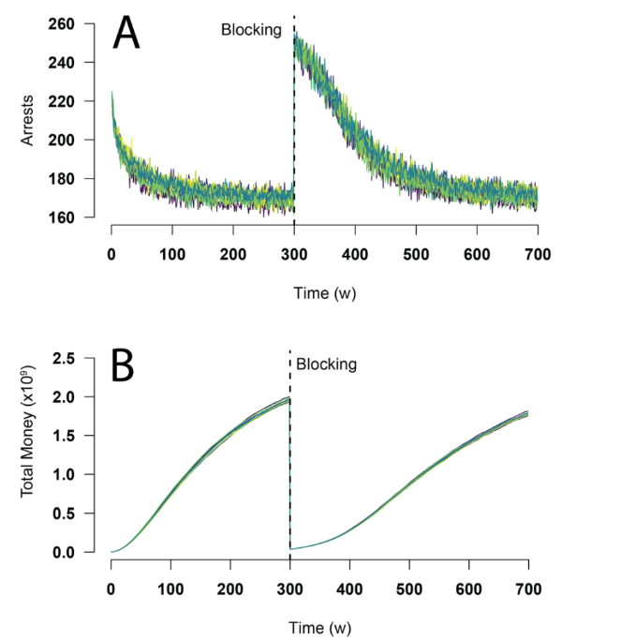
In the simulation model, after 300 weeks all money from 80% of the richest criminals in the criminal network is seized. (vertical line)
Number of arrests sharply increase after the blocking, indicating there is not enough money to bribe the police officers and get away.
Total money in the criminal network decreases after the blocking, but returns to previous maximum after a while.
This implies that the amount of crime-associated money that is confiscated has little impact on the long-term crime incidence.
Notes:
#3

Slide 9
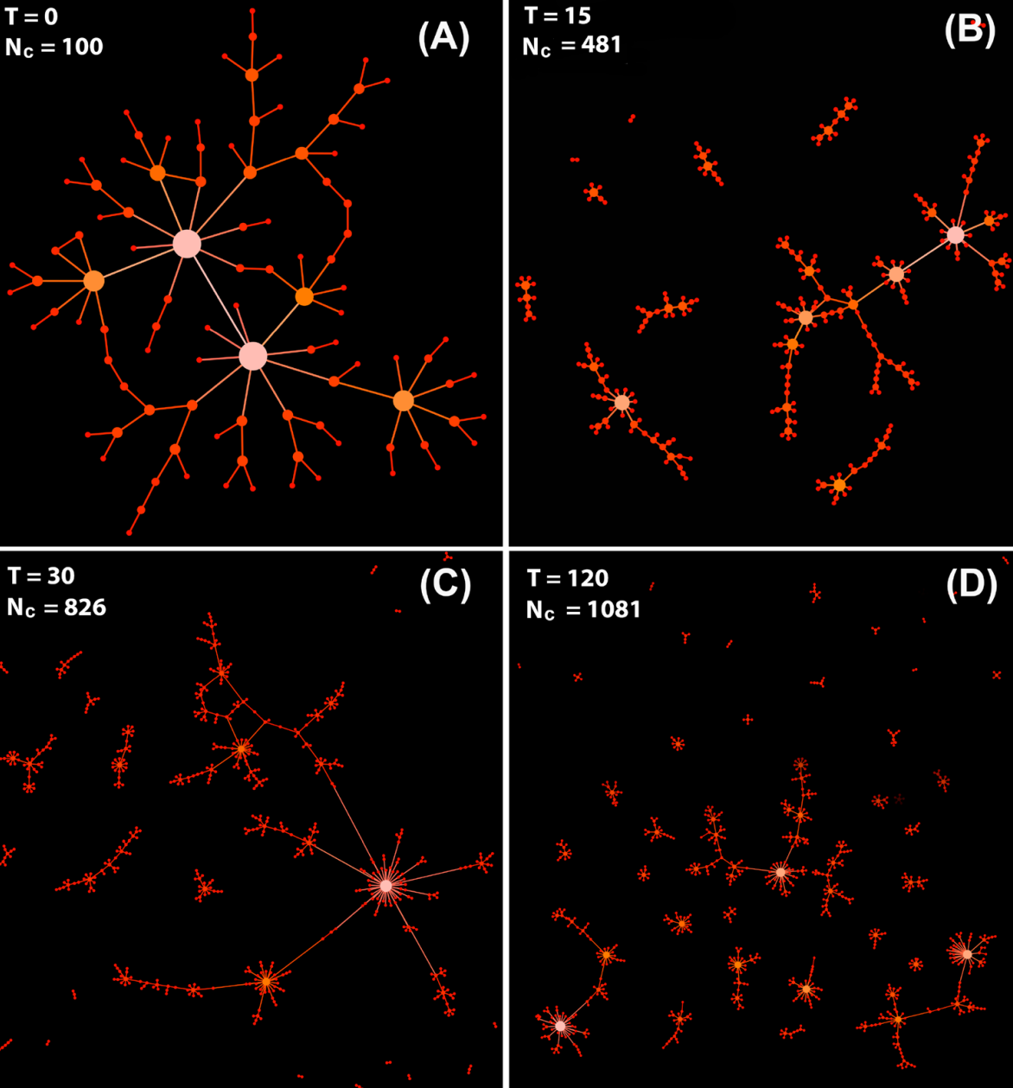
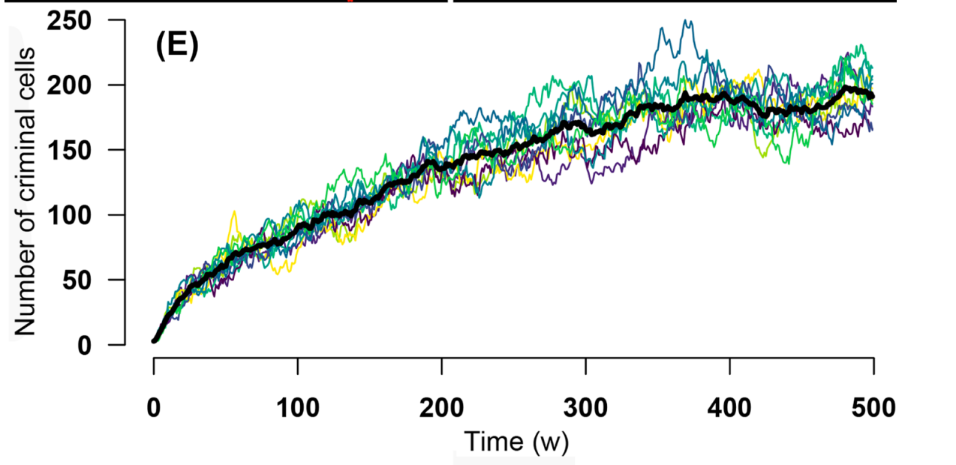
Evolution of the criminal network.
Figure A shows an initial fully connected criminal network, which exhibits a scale-free-like topology. Hubs can be seen in the network.
Figures B, C, and D show the effects of police officers capturing criminals.
This leads to the main criminal network breaking down into smaller subnetworks.
Figure E shows a steady increase in the number of criminal cells.
Notes:
Breaking down the network by capturing the kingpins, or removing hubs leads to disconnected networks, which do not lead to reduction in crime levels.

Slide 10
Strengths
The methodology and findings have broad applicability. The model can be adapted to other countries or regions facing similar issues, making it a valuable tool for comparative studies and international policy development.
Corruption and its perception are difficult to measure. This study quantitatively models these aspects, bridging the gap between qualitative observations and quantitative analysis.
An agent-based model offers a flexible approach to simulate complex social dynamics. It allows for the analysis of individual behaviors and their effects on the system, providing insights that are not easily obtainable.
Notes:
Corruption is very hard to measure, as no corporation will admit how much corruption they have.

Slide 11
Limitations
The model does not simulate potential conflicts between criminal groups after a large criminal organization is fractured. These conflicts can impact the dynamics of crime and violence.
The simulations do not account for the efforts of law enforcement to combat corruption within its ranks. The model might not accurately reflect the potential impact of internal anti-corruption measures.
The study does not incorporate a feedback mechanism between the public's perception of police corruption and the actual fraction of corrupt police officers. The model may not fully capture the cyclical nature of corruption, where increased perception of corruption could lead to higher levels of corruption.

Slide 12
Relation to the Course
The paper uses network analysis to determine how society perceives police corruption and correlates it to the seemingly increased crime rates due to the public's perception of them.
The models involve the construction and evolution of criminal networks, where criminals are organized in hierarchical structures. This aspect of the model allows for the analysis of network properties such as connectivity, centrality, and modularity. It also employs a preferential attachment algorithm based on money to simulate the formation of connections in the criminal network. This algorithmic approach is fundamental in understanding the emergence of network hubs and the distribution of node degrees, which was well covered in the course.
Data mining techniques were applied to analyze patterns in crime data and identify factors contributing to crime outbreaks. By analyzing this data, the paper identifies correlations and dependencies among variables related to corruption.

Slide 13
Conclusion
The results presented in this work can be considered by policy makers in developing countries in which a high perception of police corruption leads to a lack of respect for the institutions and those in charge of maintaining order (judges, prosecutors, police).
While poverty and inequality may be important for the emergence of violent crime in Mexico, they may not be the main causes.
A high perception of corruption leads citizens to disrespect authorities and behave out of the law, increasing the level of crime.
Even a slight increase in the perceived level of corruption can lead to a considerable increase in crime.
Arresting kingpins or confiscating their assets does not seem to reduce crime in the long term, but instead fractures the criminal network, creating more independent cells.

Slide 14
Questions?

Slide 15

Thanks!
Paper Link:
Modeling the role of police corruption in the reduction of organized crime: Mexico as a case study | Scientific Reports

